Slide 1



APPLIED DATA SCIENCE CAPSTONE
Predicting SpaceX Falcon 9 first-stage booster reuse outcomes using a custom REST API pipeline, web scraping, geospatial analytics, interactive dashboards, and supervised classification machine learning models.
Lahcen Mokhtar AMROUNE
|
July 2026
https://github.com/LahcenAmroune/Applied-Data-Science-Capstone

Slide 2

OUTLINE
Executive Summary
Intoduction
Methodology
Results
Discussion
Conclusion

Slide 3
Executive Summary & Overview
This Applied Data Science capstone project was centered on the prediction of SpaceX Falcon 9 first-stage landing outcomes—a practical challenge situated at the intersection of aerospace engineering and data-driven modeling.
The work commenced with the collection and preprocessing of launch records, during which the data were cleansed, structured, and transformed into an analyzable format. Exploratory data analysis was then conducted to uncover latent patterns and correlations within the dataset.
Through the use of interactive visualization techniques, the influence of key predictors—including payload mass, orbital destination, and booster configuration—on mission success was systematically examined.
A range of machine learning classifiers was subsequently trained and evaluated. Among these, the Decision Tree algorithm yielded the highest predictive accuracy for landing success.
Overall, this project contributed to both technical competency in data science and a broader appreciation for its application in high-stakes, real-world domains such as spaceflight operations.

Slide 4
Introduction
In this capstone, the prediction of whether the Falcon 9 first stage will land successfully is undertaken. Falcon 9 rocket launches are advertised by SpaceX on its website at a cost of 62 million dollars; costs of upward of 165 million dollars per launch are charged by other providers. Much of this savings is accounted for by the reusability of the first stage by SpaceX. Therefore, if the successful landing of the first stage can be determined, the cost of a launch can also be determined. This information can be used if a bid against SpaceX for a rocket launch is being considered by an alternate company.
Most unsuccessful landings are planned. Occasionally, a controlled landing in the ocean is performed by SpaceX.
The main question that is being addressed is this: given a set of features about a Falcon 9 rocket launch—which include its payload mass, orbit type, launch site, and so on—will a successful landing of the first stage be achieved?

Slide 5
Methodology
Data collection methodology :
Retrieval and consolidation from multiple SpaceX API endponts
Web scaping tabular data from Wikipedia
Perform data wrangling
Extracted relevant records
Flattened fields and resolved missing values endpoints
Perform exploratory data analysis (EDA) using visualization and SQL
Visualize variable relationships
Look at the data in aggregate
Perform interactive visual analytics using Folium and Plotly Dash
Mark all launch sites on a map
Mark successful and failed launches
Calculate distances to proximate locations
Provide for interactive exploration of the data
Perform predictive analysis using classification models 7
Build, evaluate, and compare several predictive classification models

Slide 6
Data Collection
Data was collected using a combination of retrieval techiniques:
HTTP requests, SpaceX API :
Initial lauch data was obtained from : /v4/launches/past
Additional data was backfilled from:
/V4/rockests
/V4/launchpads
/V4/playloads
/V4/cores
Tabular data from the : List of Falcon 9 and Falcon Heavy launches – Wikipedia page.

Slide 7
Data collection, wrangling and formating
The initial data were obtained from the /v4/launches/past API endpoint. Additional data were backfilled from the rocket, launchpad, payloads, and cores API endpoints, for records with extant corresponding IDs.
The API that was used in this capstone project was provided by Coursera: https://api.spacexdata.com/v4/rockets/ Data about different rocket launches were obtained using the SpaceX API. However, because this project was focused exclusively on Falcon 9, the data were filtered to include only Falcon 9 launches. Missing values were identified in some columns, and these were filled with the average (mean) of the respective column.
In the end, a cleaned dataset consisting of 90 rows (launch records) and 17 columns (features) was produced. A preview of the dataset after cleaning is shown below.
https://github.com/LahcenAmroune/Applied-Data-Science-Capstone/blob/main/1%20Data%20Collection%20API.ipynb

Slide 8
Data collection, wrangling and formating
Web Scraping Workflow
A web scraping workflow was implemented. An HTTP GET request was sent to the Falcon 9 Launch page at Wikipedia, and the HTML source was retrieved. A BeautifulSoup object was then created to extract the tables containing launch data. A Pandas DataFrame was populated using the extracted columns.
Data Source
The data used in this project were scraped from https://en.wikipedia.org/w/index.php?title=List_of_Falcon_9_and_Falcon_Heavy_launches&oldid=1027686922
Specifically, the website provides data related only to Falcon 9 launches.
https://github.com/LahcenAmroune/Applied-Data-Science-Capstone/blob/main/2%20Data%20Collection%20with%20Web%20Scraping.ipynb

Slide 9
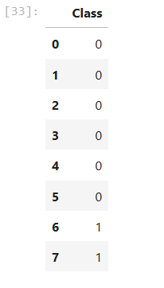
Data collection, wrangling and formating
Goals
The following goals were established for this phase of the project: the use of Exploratory Data Analysis (EDA) was planned to identify patterns within the data, and the determination of labels for the training of supervised models was also undertaken.
Steps
A series of analytical steps were performed. Missing values were calculated as a percentage of each attribute. Column types were identified and classified as either numerical or categorical. The distribution of launches per launch site was visualized, and the distribution of orbit types present in the dataset was also examined. Launch outcomes were explored and subsequently grouped by binary outcome—success or failure. A new column, designated as "Class," was created to store these outcomes, and this column was intended to be used as the target value during model training.
Data Preprocessing
Following the exploratory phase, the data were cleaned to remove any remaining missing values. All categorical features were converted into numerical form through the application of one-hot encoding. Additionally, a new column called 'Class' was added to indicate the outcome of each launch—where '0' was assigned to failed launches and '1' was assigned to successful ones. After this preprocessing was completed, a final dataset containing 90 rows (launches) and 83 columns (features) was obtained.
https://github.com/LahcenAmroune/Applied-Data-Science-Capstone/blob/main/3%20Data%20Collection%20data%20wrangling.ipynb

Slide 10
Exploratory Data Analysis (EDA)
Pandas & NumPy Analysis
Functions from the Pandas and NumPy libraries were used to explore and understand the dataset. Several insights were extracted during this process, including: the number of launches that took place at each launch site, the frequency with which each orbit type was used, and the count and types of different mission outcomes.
SQL-Based Exploration
The dataset was further explored using SQL queries to answer key questions, such as: what the unique launch sites in the dataset are, how much total payload mass was launched by NASA (CRS) missions, and what the average payload mass is for the booster version F9 v1.1.
Data Visualization
Matplotlib and Seaborn
Matplotlib and Seaborn were used to create various types of plots, including scatter plots, bar charts, and line charts. These visualizations were instrumental in understanding key relationships within the data, such as how launch site varies with flight number, how payload mass is distributed across launch sites, and how orbit type is related to the success rate of launches.

Slide 11
Exploratory Data Analysis (EDA)
Interactive Mapping with Folium
Interactive maps were created using Folium to enable deeper spatial understanding. With Folium, the following were achieved: all launch sites were plotted on a map, successful and failed launches were highlighted at each site, and distances from launch sites to nearby locations—such as cities, highways, and railways—were displayed.
Interactive Dashboard with Dash
An interactive web dashboard was built using Dash, allowing users to explore the data through a dropdown menu and a range slider. The dashboard includes a pie chart that shows the total number of successful launches from each launch site, as well as a scatter plot that reveals the relationship between payload mass and mission outcome (success or failure) for different launch sites.
Machine Learning Prediction
Library: Scikit-learn.
Process: The workflow includes data standardization and splitting data into training/testing sets.
Models: Implements Logistic Regression, SVM, Decision Trees, and KNN.
Evaluation: Models are tuned via hyperparameter optimization and assessed using accuracy scores and confusion matrices.

Slide 12
Exploratory Data Analysis (EDA)
Model Development and Evaluation
The Scikit-learn library was used for the construction and evaluation of multiple machine learning models. The following prediction pipeline was carried out:
The data were standardized to enhance model performance.
The dataset was divided into training and testing sets.
Four different classification models were trained:
Logistic Regression
Support Vector Machine (SVM)
Decision Tree
K-Nearest Neighbors (KNN)
Each model was fitted on the training data.
Hyperparameters were tuned to determine the optimal settings for each model.
Model performance was evaluated using:
Accuracy scores, which were calculated for each model
Confusion matrices, which were generated for each model

Slide 13
EDA with SQL
SQL Queries :
Show each unique launch site
Show 5 records where launch site names begin with 'CCA'
Display the total payload mass carried by boosters launched by 'NASA (CRS)'
Display the average payload mass carried by the v1.1 Falcon 9 booster
List the date of the first successful ground landing outcome
List the booster versions with successful outcomes landing on the drone ship with payloads between 4000kg and 6000kg.
List the number of successful and failed mission outcomes
List all of the booster versions that carried the max payload mass
List the month name, outcome, booster version, and launch site for missions with failure outcomes landing on a drone ship in 2015.
Show the distribution of outcomes between June 4th, 2010 and March 20th, 2017
https://github.com/LahcenAmroune/Applied-Data-Science-Capstone/blob/main/4%20EDA%20SQL.ipynb

Slide 14

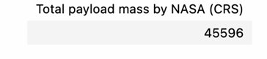
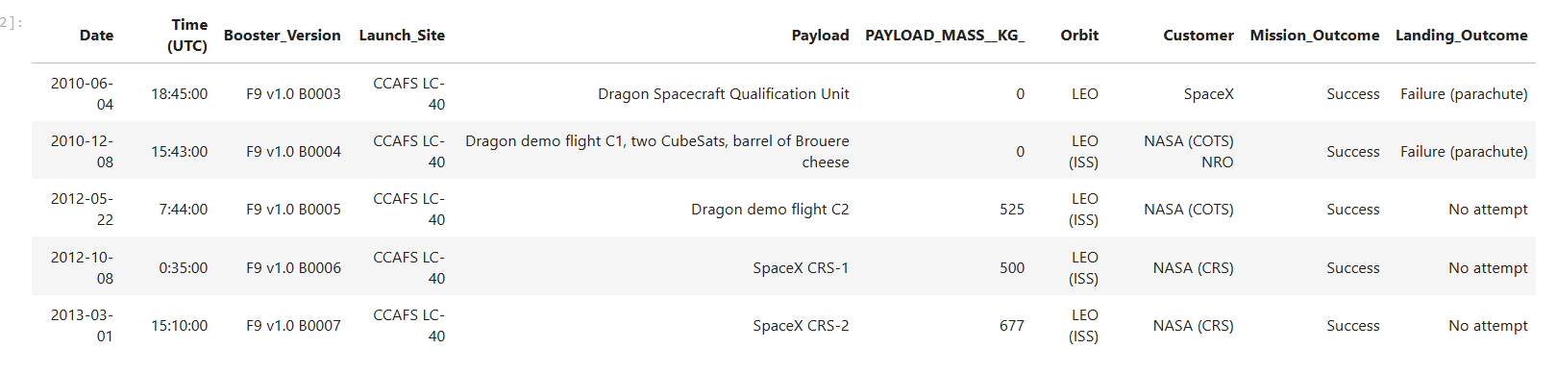
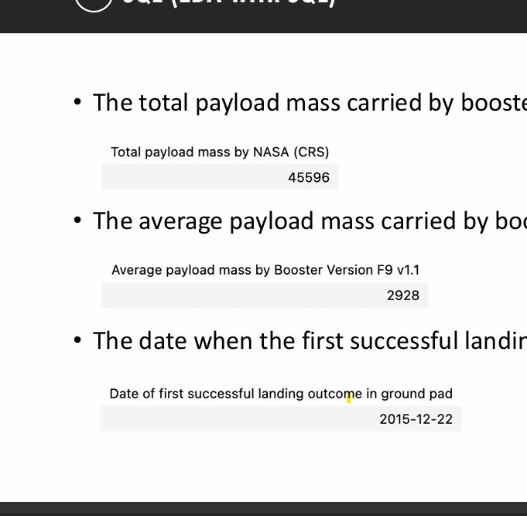
EDA with SQL
Total payload mass transported by boosters for NASA (CRS) missions
Retrieving the names of all unique launch sites involved in the SpaceX missions to understand how many different sites were used
Filtering the data to show only those launch sites that begin with 'CCA' revealing 5 specific records matching this condition
• Theaverage payload mass carried by booster version F9 v1.1

Slide 15
EDA with SQL
Total payload mass transported by boosters for NASA (CRS) missions
Retrieving the names of all unique launch sites involved in the SpaceX missions to understand how many different sites were used
Filtering the data to show only those launch sites that begin with 'CCA' revealing 5 specific records matching this condition
• Theaverage payload mass carried by booster version F9 v1.1

Slide 16

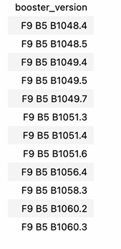
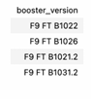
EDA with SQL
• Thedate whenthe first successful landing outcome in ground pad was achieved
• The total number of successful and failure mission outcomes
• The names of the boosters which have success in drone ship and have payload mass greater than 4000 but less than 6000
The names of the booster versions which have carried the maximum payload mass

Slide 17
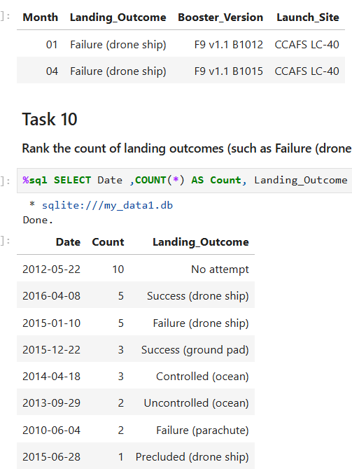
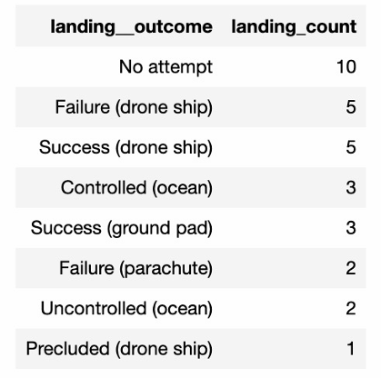
EDA with SQL
The failed landing outcomes in drone ship, their booster versions, and launch site names for in year 2015
The count of landing outcomes between the date 2010-06-04 and 2017-03-20, in descending order

Slide 18
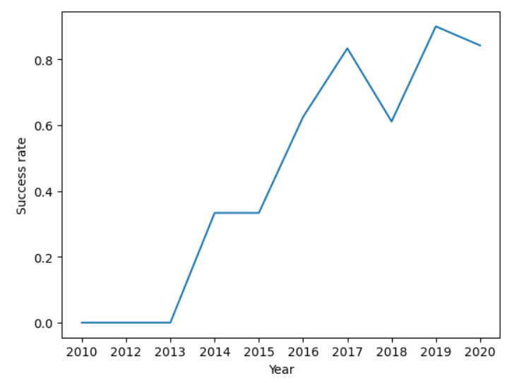
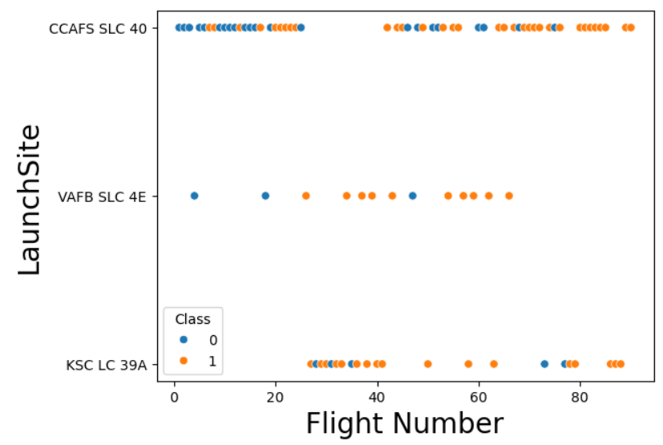
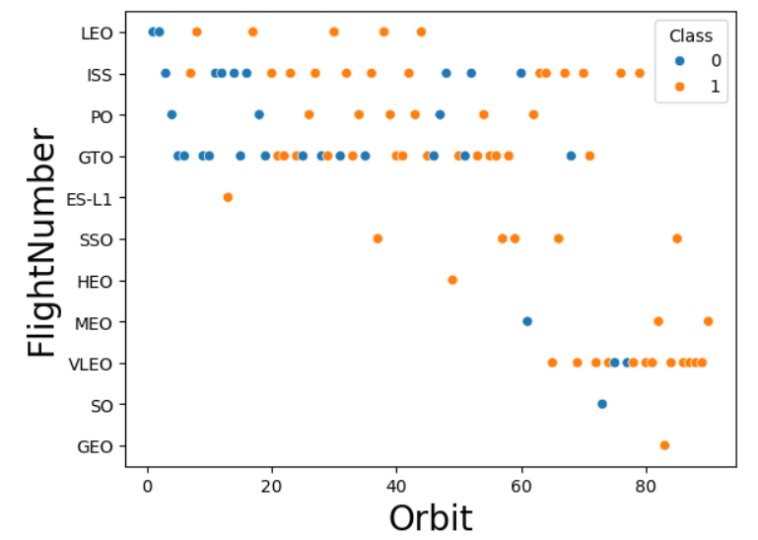
EDA with Data Visualization
Smploy data visualization techniques to evaluate the contribution of individual features and their impact on target outcomes.:
Visualize the relationship between Flight Number and Launch Site
Visualize the relationship between Payload and Launch Site
Visualize the relationship between success rate of each orbit type
Visualize the relationship between FlightNumber and Orbit type
Visualize the relationship between Payload and Orbit type
Visualize the launch success yearly trend

Slide 19
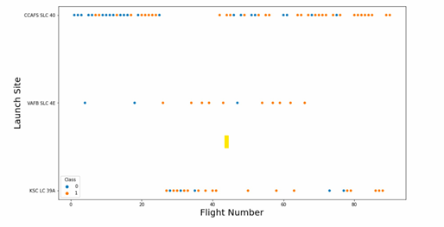
EDA with Data Visualization
• The relationship between flight number and launch site

Slide 20
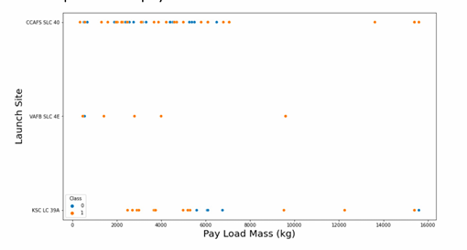
EDA with Data Visualization
• The relationship between payload mass and launch site

Slide 21
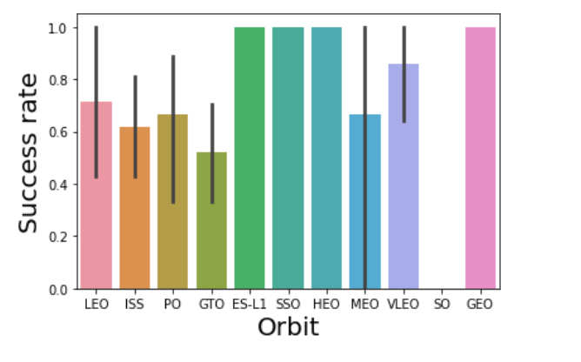
EDA with Data Visualization
• The relationship between success rate and orbit type

Slide 22
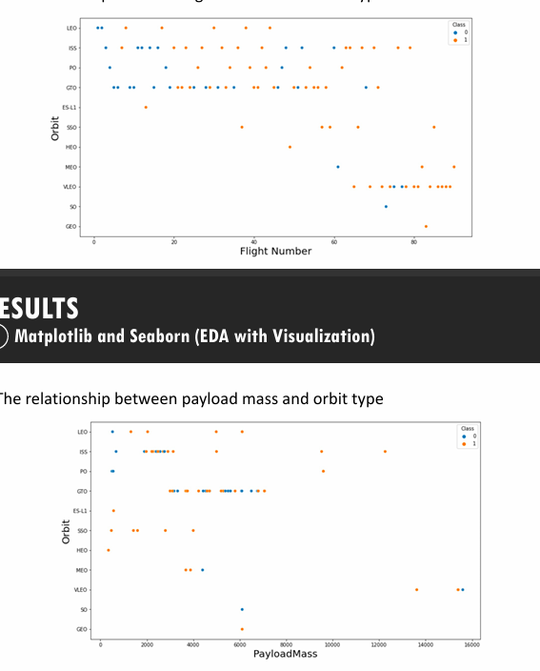
EDA with Data Visualization
• The relationship between flight number and orbit type

Slide 23
EDA with Data Visualization
• The relationship between payload mass and orbit type

Slide 24
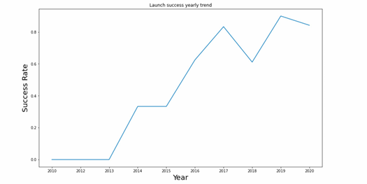
EDA with Data Visualization
• The launch success yearly trend

Slide 25
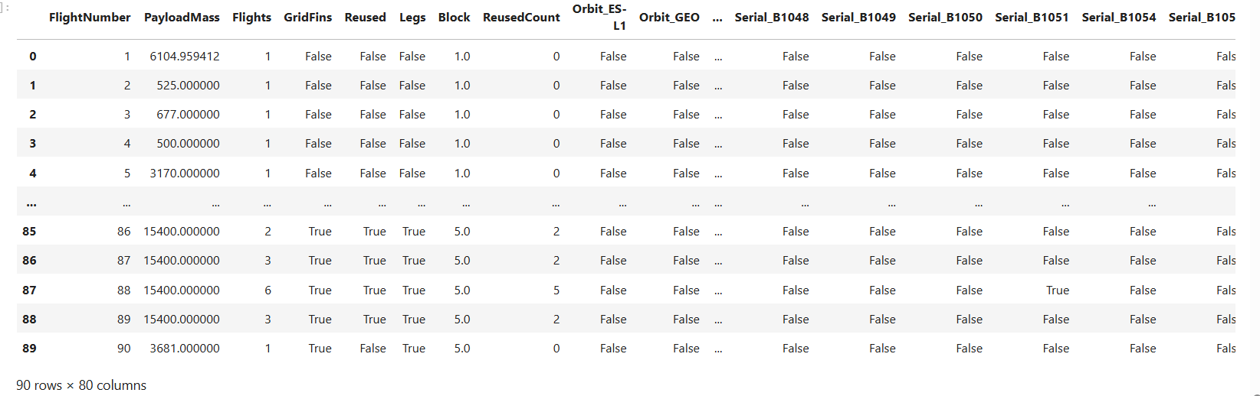
EDA with Data Visualization
Features Engineering : Creation of dummy variables to categorical columns
https://github.com/LahcenAmroune/Applied-Data-Science-Capstone/blob/main/5%20EDA%20Visualization.ipynb

Slide 26
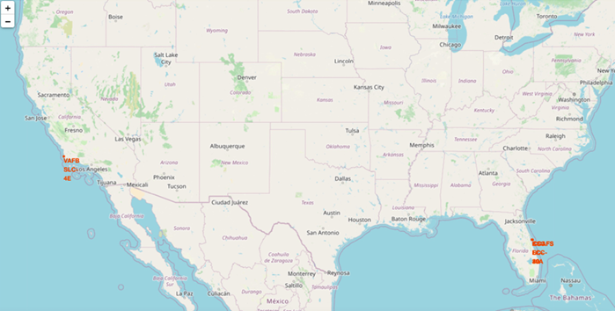
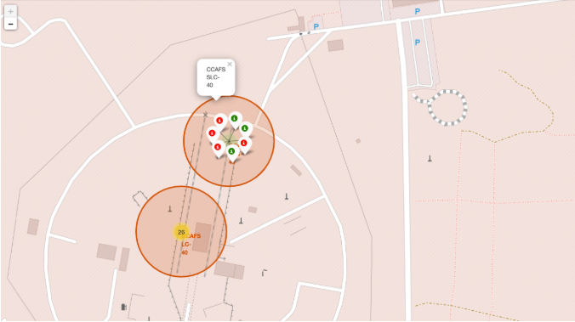
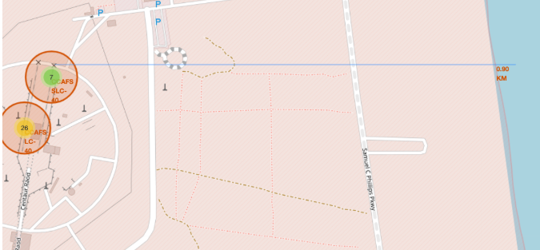
Interactive Visual Analytics with Folium
identify spatial patterns, the following geographic features were plotted on a map of launch sites:
All Launch Sites
Successful and Failed Launches
Distances between a launch site and proximate landmarks
Geographic analysis was conducted by visualizing launch site coordinates, mission outcome distributions, and distances to key landmarks on an interactive map.
https://github.com/LahcenAmroune/Applied-Data-Science-Capstone/blob/main/6%20Interactive%20Visual%20Analytics%20with%20Folium%20lab.ipynb

Slide 27
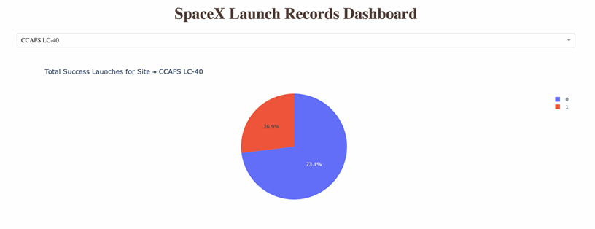
Interactive Visual Analytics and Dashboard
The figure below presents a pie chart illustrating the launch outcomes for site CCAFS LC-40, where 0 denotes failed launches and 1 denotes successful launches. As shown, 73.1% of launches from this site resulted in failure.
The pie chart below visualizes the outcome distribution for CCAFS LC-40, with failure represented by 0 and success by 1. Notably, the majority of launches—73.1%—from this site were unsuccessful.

Slide 28
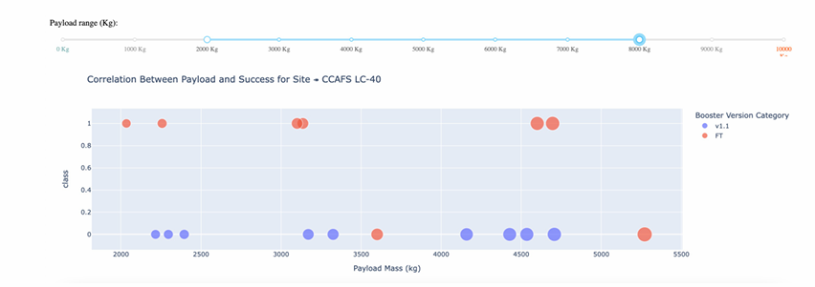
Interactive Visual Analytics and Dashboard
• The picture below shows a scatterplot when the payload mass range is set to be from 2000kg to 8000kg.
• Class 0 represents failed launches while class 1 represents successful launches.
https://github.com/LahcenAmroune/Applied-Data-Science-Capstone/blob/main/7%20spacex%20dash%20app.py

Slide 29
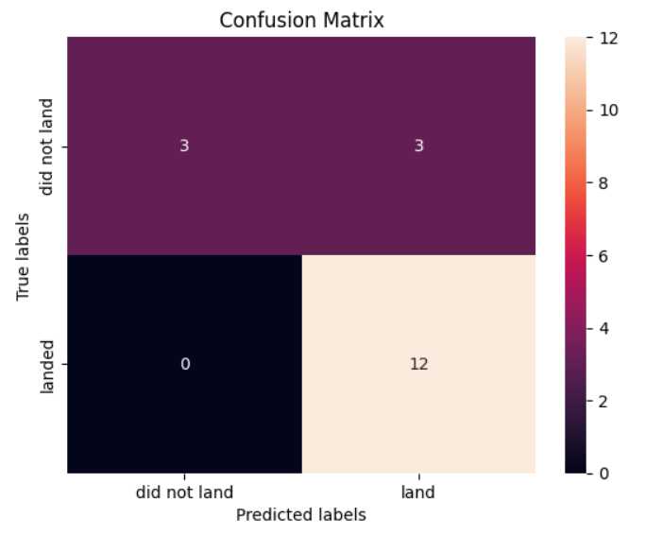
Machine Learning Prediction
Logistic regression
GridSearchCV best score: 0.8464285714285713
Accuracy score on test set: 0.8333333333333334
Confusion matrix:

Slide 30
Machine Learning Prediction
Support Vector Machine (SVM)
GridSearchCV best score: 0.8482142857142856
Accuracy score on test set: 0.8333333333333334
Confusion matrix:

Slide 31
Machine Learning Prediction
Decision Tree
GridSearchCV best score: 0.8892857142857142
Accuracy score on test set: 0.8333333333333334
Confusion matrix:

Slide 32
Machine Learning Prediction
K nearest neighbors (KNN)
GridSearchCV best score: 0.8482142857142858
Accuracy score on test set: 0.8333333333333334
Confusion matrix:
https://github.com/LahcenAmroune/Applied-Data-Science-Capstone/blob/main/8%20Machine%20Learning%20Prediction.ipynb

Slide 33
Discussion
Despite all four models—Logistic Regression, SVM, Decision Tree, and KNN—achieving identical test-set accuracy (83.3%) and confusion matrices, their performance diverged under hyperparameter tuning. To establish a definitive ranking, we compared their respective GridSearchCV best scores. Ordered from highest to lowest, the results are as follows: Decision Tree (0.889), K-Nearest Neighbors (0.848), Support Vector Machine (0.848), and Logistic Regression (0.846). This places the Decision Tree as the optimal model after parameter optimization.
Success rates have shown a steady upward trajectory over time across all factors, reflecting ongoing incremental operational improvements and technological advancements. Performance varies by orbit, with ES-L1, SSO, HEO, and GEO consistently achieving successful outcomes. Launch site also proved to be a highly predictive factor, with KSC LC-39A emerging as the top performer, closely followed by CCAFS LC-40. Among the predictive models evaluated, most achieved acceptable accuracy in forecasting landing outcomes, with the DecisionTreeClassifier delivering the best performance overall, demonstrating high accuracy, precision, and recall.

Slide 34
Appendix
Data sources
r/SpaceX API Docs
List of Falcon 9 and Falcon Heavy launches – Wikipedia

Slide 35
Conclusion
In this project, we set out to predict whether the first stage of a given Falcon 9 launch would land successfully, in order to determine the cost of a launch. Each feature of a Falcon 9 launch, such as payload mass or orbit type, may affect the mission outcome in a certain way. Several machine learning algorithms were employed to learn patterns from past Falcon 9 launch data and produce predictive models that can be used to predict the outcome of future launches. Among the four algorithms tested, the Decision Tree Classifier performed the best.
Our analysis revealed that success rates have increased over time across all factors, indicating continuous and incremental operational improvements and technological advancements. Different orbits exhibit varying success rates, with ES-L1, SSO, HEO, and GEO showing consistently successful outcomes. Launch site also proved to be a highly predictive factor, with KSC LC-39A being the top performer, closely followed by CCAFS LC-40.
Overall, many of the predictive models evaluated were able to predict landing outcomes with an acceptable level of accuracy. In the testing performed, the Decision Tree Classifier produced the best results, achieving high accuracy, precision, and recall.
If you'd prefer a shorter version, a bullet-point version, or a version that merges your original and new text differently, just let me know.

Slide 36
Thank you!
Presented by Lahcen Mokhtar AMROUNE • July 2026 Data Science & Machine Learning Capstone | Applied Predictive Analytics

